Slide 1
faceAlter
Real Time Emojis with Facial Expressions
Hitesh Agrawal 19BAI10030
Dev Singh 19BAI10093
Akshat Bhardwaj 19BAI10188
P. Yash Reddy 19BAI10190
Guide:
Dr. Pon Harshavardhananan
SCSE - spl. Artificial Intelligence and Machine Learning (B.Tech)
DSN2099 - Project Exhibition-II

Slide 2
Introduction
Artificial Intelligence is an interdisciplinary branch of computer science, however, a good part of it is commercialized now as a technology. It involves computers “learning” from a massive amount of data so that they can do tasks that normally require human intervention. Computer scientists and mathematicians have conducted decades of research and development on AI.
If you are wondering why AI matters, then you only have to look at the wide range of use cases it has. A few examples of AI use cases are as follows :
Static image recognition, classification, and tagging
Algorithmic trading (basically through Trading Bots)
Predictive maintenance of equipment in heavy industries
Processing patient data in an efficient and scalable manner
Artificial Intelligence “trains” computer systems using algorithms so that an AI-powered system can progressively improve its performance. One such application of this outstanding branch is the Facial Recognition that has been used in various fields such as security purposes and fun applications these are efficient and this is the task that we are designing in our current project.

Slide 3
Ideology behind faceAlter
Emoji are ideograms used in messages and webpages to interact in a way that resembles the way we feel. Emojis are of different kinds, facial expressions, common objects, places and animals. It also lead to increasing data science research dedicated to emoji-driven storytelling.
This project is based on making emojis using machine learning from an image. With advancements in computer vision and deep learning, it is now possible to detect human emotions from images. In this project, we will classify human facial expressions to filter and map corresponding emojis.
In order to do so, we will be utilising the convolution neural network feature to recognize facial emotions, and for that purpose the dataset to be used is “FER2013”. The model will be trained using this dataset to map the emotion to the corresponding emoji. The input will be fed to the model in the form of a “box” which will be obtained using haarcascade xml by OpenCV which will generate the bounding box of the faces in the webcam.

Slide 4
About the Dataset
The FER2013 or Facial Expression Recognition dataset consists of 48*48 pixel grayscale face images. The images are centered and occupy an equal amount of space. This dataset consist of facial emotions of following categories:
0: Angry
1: Disgusted
2: Fearful
3: Happy
4: Neutral
5: Sad
6: Surprised
(Download FER2013: www.kaggle.com/deadskull7/fer2013)

Slide 5
Existing work with Limitations
AR (Augmented Reality) Emoji is a feature which creates an animated version of yourself which can then be used to record your movements and facial expressions.
AR Emoji Mask
The AR Mask is perfect when you want to show off your new outfit but you may not be looking your best. To enable the AR Mask, simply tap the second icon on the top right of the screen. When your face has been recognised your AR Emoji will copy your facial expressions, try frowning or smiling or poking your tongue out.
Motion Figure
Motion Figure allows you to take a photo of your current surrounds and lets you play with your AR Emoji. It's as simple as tapping on the Motion Figure icon, holding with a steady hand to take a clear photo of your surrounds and tapping on your AR Emoji once its popped up on your screen.

Slide 6
Proposed Work and Methodology
As mentioned earlier, we will be building a convolution neural network architecture using OpenCV and train our model using FER2013 dataset.
The workflow of faceAlter is a 3 stage process:
Stage 1 - Facial detection and tracing
Stage 2 - Extraction of features
Stage 3 - Classification
The model uses haarcascade xml to detect the face and traces the bounding box in the webcam capturing a frame which is then preprocessed. After preprocessing and extraction of the required features, the feature points are then fed to the model for classification.

Slide 7
Steps to be followed
Step 1: To choose a suitable programming language
Programming languages like Python are the most popular and suited languages to develop a Machine Learning model as they are extremely flexible and versatile and if in case we want to further develop our model in the future, it is going to make our work easier.
Step 2: To choose a platform/IDE
Pycharm or Anaconda are the most preferred platforms for developing machine learning models.
Step3: Understanding the basic concepts required
faceAlter deals with various niches of computer science making it a sophisticated machine learning model. The pre requisites for the development are fundamentals of computer vision, basic understanding of deep learning concepts, knowledge about convolutional neural networks and OpenCV.

Slide 8
Steps to be followed
Step 4: Understanding objective and capabilities of faceAlter
This is also one of the most crucial aspects of our model as the user should be clear about what can it do and what it is made to do.
Step 5: Developing the model
Goal in this should be to keep the code simple and concise so that it is easier to optimize and traverse. While building the model make sure that proper documentation is done in order to make it easier for the end user to understand faceAlter. Proper code ethics and good decision making flow should be implemented.
Step 6: Training - Testing - Optimising
Keeping logs is a fantastic way to keep our model updated. Any kind of errors can be identified easily by the timestamps in the log file. Using 70:30 ratio of dataset we train our model and then we test it thoroughly. We keep tabs of all the processes to look for ways to optimise our model and get better and more accurate results.

Slide 9
Real time usage
Novelty
This project is based upon real time video and image monitoring which will then be processed and be reflected upon the emoji or avatar.
The are not many applications that endorse this feature and some are quite unreliable. This gives faceAlter a headstart in the market as a good competitor. FaceAlter works in a real-time environment and has a trigger mechanism to capture a frame which will then be further processed to generate a reliable output. It uses a vast range of training data and is then trained using optimal technique to generate best possible output.

Slide 10
Hardware and Software Requirements
(Windows)
Recommended hardware specifications are:
Quad-core processor (2.0 GHz and up)
6 GB memory and up
Stable wired internet connection (minimum 5mbit download)
Recommended software specifications are:
PyCharm - Python IDE
Minimum software specifications on Microsoft Windows
Windows 8 or 8.1 and 10 (32-bit and 64-bit)
Windows Server 2003 SP2 and newer
Microsoft .NET 4.5.2

Slide 11
Hardware and Software Requirements
(MacOS)
Recommended hardware specifications are:
Quad-core processor (2.0 GHz and up)
6 GB memory and up
Stable wired internet connection (minimum 5mbit download)
Recommended software specifications are:
PyCharm - Python IDE

Slide 12
Hardware and Software Requirements
(Linux)
Recommended hardware specifications are:
Quad-core processor (2.0 GHz and up)
4 GB memory and up
Stable wired internet connection (minimum 5mbit download)
Recommended software specifications are:
PyCharm - Python IDE

Slide 13
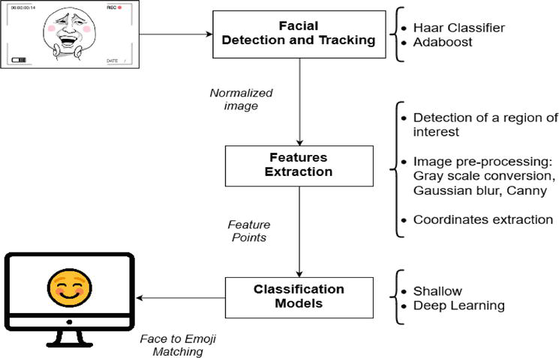
Overall System Architecture Diagram

Slide 14
Literature
The project Face Alter, is based on making emojis using machine learning from an image.
To do so, we will be building a model which will be utilising the convolution neural network feature to recognize facial emotions, and for that purpose the dataset to be used is “FER2013”. The detection of emotions or facial expressions requires analysis and assessment of decisions in predicting a person's emotions or group of people in communicating. This research proposes the design of a system that can predict and recognize the classification of facial emotions based on feature extraction using the Convolution Neural Network (CNN) algorithm in real-time.
The model will be trained using this dataset to map the emotion to the corresponding emoji. The input will be fed to the model in the form of a “box” which will be obtained using haarcascade xml by OpenCV which will generate the bounding box of the faces in the webcam.
There on, facial features aka emotions would be extracted then fed to model to classify them under given 6 facial expressions and then display them in real time.
At last we will have a real time emojifier of yourself.

Slide 15
Module Description
NumPy: NumPy is a Python library that provides a simple yet powerful data structure: n-dimensional array. In that, NumPy enriches the programming language Python with powerful data structures, implementing multi-dimensional arrays and matrices. These data structures guarantee efficient calculations with matrices and arrays.
OpenCv/cv2: OpenCV is a cross-platform library using which we can develop real-time computer vision applications. It mainly focuses on image processing, video capture and analysis including features like face detection and object detection.
Keras: Keras is an open-source software library that provides a Python interface for artificial neural networks. Keras acts as an interface for the TensorFlow library. It was developed to make implementing deep learning models as fast and easy as possible for research and development.
Keras.layers
Keras.optimizers
Keras.preprocessing.image
Keras.emotion_models

Slide 16
4. PIL: Python Imaging Library is a free and open-source additional library for the Python programming language that adds support for opening, manipulating, and saving many different image file formats.
5. OS: The OS module in Python provides functions for creating and removing a directory (folder), fetching its contents, changing and identifying the current directory, etc.
6. Tkinter: Tkinter is the standard GUI library for Python. Python when combined with Tkinter provides a fast and easy way to create GUI applications. Tkinter provides a powerful object-oriented interface to the Tk GUI toolkit.

Slide 17
Module Workflow
OpenCv: OpenCV uses machine learning algorithms to search for faces within a picture. Because faces are so complicated, there isn’t one simple test that will tell you if it found a face or not. Hence the algorithms break the task of identifying the face into thousands of smaller, bite-sized tasks, each of which is easy to solve. These tasks are also called classifiers.
Which here in this project is “haarcascade_frontalface_default.xml”
So, for something like face, there can be as many as 60000 classifiers. And to check a face against each of them might be a serious task even for an computer at once for a quick and efficient response.
Hence the OpenCV cascade breaks the problem of detecting faces into multiple stages. For each block, it does a very rough and quick test. If that passes, it does a slightly more detailed test, and so on. The algorithm may have 30 to 50 of these stages or cascades, and it will only detect a face if all stages pass.
Advantage: Instead of taking hours, face detection can now be done in real time.

Slide 18
Image Detection by OpenCv:
Reading image
Convert image to GrayScale for algorithm to work
Detect face using Haarcascade Classifier and the algorithm
Save the list of coordinates of rectangular region from Step 3.
Outline the detected faces using the the list of coordinates for the rectangular regions where faces were found.
Furthermore, OpenCv has been used to convert GrayScale image from video frames at required locations.
2. NumPy: It is being used to deal with image pixels in the form of multi dimensional arrays. It makes it easier to deal with images and apply various algorithms.
By reading the image as a NumPy array ndarray , various image processing can be performed using NumPy functions

Slide 19
Implementation and Coding
#Importing necessary modules/libraries for training
import numpy as np
import cv2
from keras.models import Sequential
from keras.layers import Dense, Dropout, Flatten
from keras.layers import Conv2D
from keras.optimizers import Adam
from keras.layers import MaxPooling2D
from keras.preprocessing.image import ImageDataGenerator
#Setting up global variables
train_dir = 'C:/Users/aksha/Desktop/Project/FER2013/train'
val_dir = 'C:/Users/aksha/Desktop/Project/FER2013/test'
train_datagen = ImageDataGenerator(rescale=1./255)
val_datagen = ImageDataGenerator(rescale=1./255)

Slide 20
train_generator = train_datagen.flow_from_directory(
train_dir,
target_size=(48,48),
batch_size=64,
color_mode="grayscale",
class_mode='categorical')
validation_generator = val_datagen.flow_from_directory(
val_dir,
target_size=(48,48),
batch_size=64,
color_mode="grayscale",
class_mode='categorical')

Slide 21
#Preparing model for training
emotion_model = Sequential()
emotion_model.add(Conv2D(32, kernel_size=(3, 3), activation='relu', input_shape=(48,48,1)))
emotion_model.add(Conv2D(64, kernel_size=(3, 3), activation='relu'))
emotion_model.add(MaxPooling2D(pool_size=(2, 2)))
emotion_model.add(Dropout(0.25))
emotion_model.add(Conv2D(128, kernel_size=(3, 3), activation='relu'))
emotion_model.add(MaxPooling2D(pool_size=(2, 2)))
emotion_model.add(Conv2D(128, kernel_size=(3, 3), activation='relu'))
emotion_model.add(MaxPooling2D(pool_size=(2, 2)))
emotion_model.add(Dropout(0.25))
emotion_model.add(Flatten())
emotion_model.add(Dense(1024, activation='relu'))
emotion_model.add(Dropout(0.5))
emotion_model.add(Dense(7, activation='softmax'))
# emotion_model.load_weights('emotion_model.h5')

Slide 22
#Training the model
cv2.ocl.setUseOpenCL(False)
emotion_dict = {0: "Angry", 1: "Disgusted", 2: "Fearful", 3: "Happy", 4: "Neutral", 5: "Sad", 6: "Surprised"}
emotion_model.compile(loss='categorical_crossentropy',optimizer=Adam(lr=0.0001, decay=1e-6),metrics=['accuracy'])
emotion_model_info = emotion_model.fit_generator(
train_generator,
steps_per_epoch=28709 // 64,
epochs=1,
validation_data=validation_generator,
validation_steps=7178 // 64)
emotion_model.save_weights('emotion_model.h5')

Slide 23
#Setting up the webcam and creating bounding box
cap = cv2.VideoCapture(0)
while True:
# Find haar cascade to draw bounding box around face
ret, frame = cap.read()
if not ret:
break
bounding_box =
cv2.CascadeClassifier('C:/Users/aksha/Desktop/haarcascade_frontalface_
default.xml')
gray_frame = cv2.cvtColor(frame, cv2.COLOR_BGR2gray)
num_faces = bounding_box.detectMultiScale(gray_frame,scaleFactor=1.3,
minNeighbors=5)
for (x, y, w, h) in num_faces:
cv2.rectangle(frame, (x, y-50), (x+w, y+h+10), (255, 0, 0), 2)
roi_gray_frame = gray_frame[y:y + h, x:x + w]
cropped_img = np.expand_dims(np.expand_dims(cv2.resize(roi_gray_frame, (48,
48)), -1), 0)

Slide 24
#Setting up the webcam and creating bounding box
emotion_prediction = emotion_model.predict(cropped_img)
maxindex = int(np.argmax(emotion_prediction))
cv2.putText(frame, emotion_dict[maxindex], (x+20, y-60),
cv2.FONT_HERSHEY_SIMPLEX, 1, (255, 255, 255), 2, cv2.LINE_AA)
cv2.imshow('Video', cv2.resize(frame,(1200,860),interpolation = cv2.INTER_CUBIC))
if cv2.waitKey(1) & 0xFF == ord('q'):
break
cap.release()
cv2.destroyAllWindows()

Slide 25
#Importing necessary modules/libraries for GUI
import tkinter as tk
from tkinter import *
import cv2
from PIL import Image, ImageTk
import os
import numpy as np
#Setting up global variables
emotion_dict = {0: " Angry ", 1: "Disgusted", 2: " Fearful ", 3: " Happy ", 4: " Neutral ", 5: " Sad ", 6: "Surprised"}
emoji_dist={0:"C:/Users/aksha/Desktop/Project/emoji-creator-project-code/emojis/emojis/angry.png",1:"C:/Users/aksha/Desktop/Project/emoji-creator-project-code/emojis/emojis/disgusted.png",2:"C:/Users/aksha/Desktop/Project/emoji-creator-project-code/emojis/emojis/fearful.png",3:"C:/Users/aksha/Desktop/Project/emoji-creator-project-code/emojis/emojis/happy.png",4:"C:/Users/aksha/Desktop/Project/emoji-creator-project-code/emojis/emojis/neutral.png",5:"C:/Users/aksha/Desktop/Project/emoji-creator-project-code/emojis/emojis/sad.png",6:"C:/Users/aksha/Desktop/Project/emoji-creator-project-code/emojis/emojis/surpriced.png"}

Slide 26
global last_frame1
last_frame1 = np.zeros((480, 640, 3), dtype=np.uint8)
global cap1
show_text=[3]
#Defining functions
def show_vid2():
frame2=cv2.imread(emoji_dist[show_text[0]])
pic2=cv2.cvtColor(frame2,cv2.COLOR_BGR2RGB)
img2=Image.fromarray(frame2)
imgtk2=ImageTk.PhotoImage(image=img2)
lmain2.imgtk2=imgtk2
lmain3.configure(text=emotion_dict[show_text[0]],font=('arial',45,'bold'))
lmain2.configure(image=imgtk2)
print("b4")
#show_vid()
print("after")
lmain2.after(dlp, show_vid2)

Slide 27
def show_vid():
cap1 = cv2.VideoCapture(0, cv2.CAP_DSHOW)
if not cap1.isOpened():
print("cant open the camera1")
print("Cam is opened")
flag1, frame1 = cap1.read()
frame1 = cv2.resize(frame1,(600,500))
bounding_box =
cv2.CascadeClassifier('C:/Users/aksha/Desktop/haarcascade_frontalface_
default.xml')
gray_frame = cv2.cvtColor(frame1, cv2.COLOR_BGR2GRAY)
num_faces = bounding_box.detectMultiScale(gray_frame,scaleFactor=1.3,
minNeighbors=5)
for (x, y, w, h) in num_faces:
cv2.rectangle(frame1, (x, y-50), (x+w, y+h+10), (255, 0, 0), 2)
roi_gray_frame = gray_frame[y:y + h, x:x + w]
cropped_img = np.expand_dims(np.expand_dims(cv2.resize(roi_gray_frame, (48,
48)), -1), 0)

Slide 28
prediction = emotion_model.predict(cropped_img)
maxindex = int(np.argmax(prediction))
cv2.putText(frame1, emotion_dict[maxindex], (x+20, y-60),
cv2.FONT_HERSHEY_SIMPLEX, 1, (255, 255, 255), 2, cv2.LINE_AA)
show_text[0]=maxindex
if flag1 is None:
print ("Major error!")
elif flag1:
global last_frame1
last_frame1 = frame1.copy()
pic = cv2.cvtColor(last_frame1, cv2.COLOR_BGR2RGB)
img = Image.fromarray(pic)
imgtk = ImageTk.PhotoImage(image=img)
lmain.imgtk = imgtk
lmain.configure(image=imgtk)
lmain.after(dlp, show_vid)
#cv2.imshow('Emotion',frame1)
if cv2.waitKey(10) == ord('b'):
exit()

Slide 29
#cap1.release()
print("lol")
#show_vid2()
print("no")
#cv2.destroyAllWindows()

Slide 30
#Main function and GUI
if __name__ == '__main__':
root=tk.Tk()
img = ImageTk.PhotoImage(Image.open("C:/Users/aksha/Desktop/pure-black-background-f82588d3.jpg"))
heading = Label(root,image=img,bg='black')
heading.pack()
heading2=Label(root,text="Photo to Emoji",pady=0, font=('arial',45,'bold'),bg='black',fg='#CDCDCD')
heading2.pack()
lmain = tk.Label(master=root,padx=50,bd=10)
lmain2 = tk.Label(master=root,bd=10)
lmain3=tk.Label(master=root,bd=10,fg="#CDCDCD",bg='black')
lmain.pack(side=LEFT)
lmain.place(x=50,y=250)

Slide 31
lmain3.pack()
lmain3.place(x=960,y=250)
lmain2.pack(side=RIGHT)
lmain2.place(x=900,y=350)
root.title("Photo To Emoji")
root.geometry("1400x900+100+10")
root['bg']='black'
exitbutton = Button(root,text='Quit',fg="red",command=root.destroy
font=('arial',25,'bold')).pack(side = BOTTOM)
show_vid()
show_vid2()
root.mainloop()

Slide 32
Demo Video
Link:
https://drive.google.com/file/d/1gqYtSkRnz3HE0j3he6DpJwfPz6fl4jk8/view?usp=sharing

Slide 33
Snapshots of the Project

Slide 34
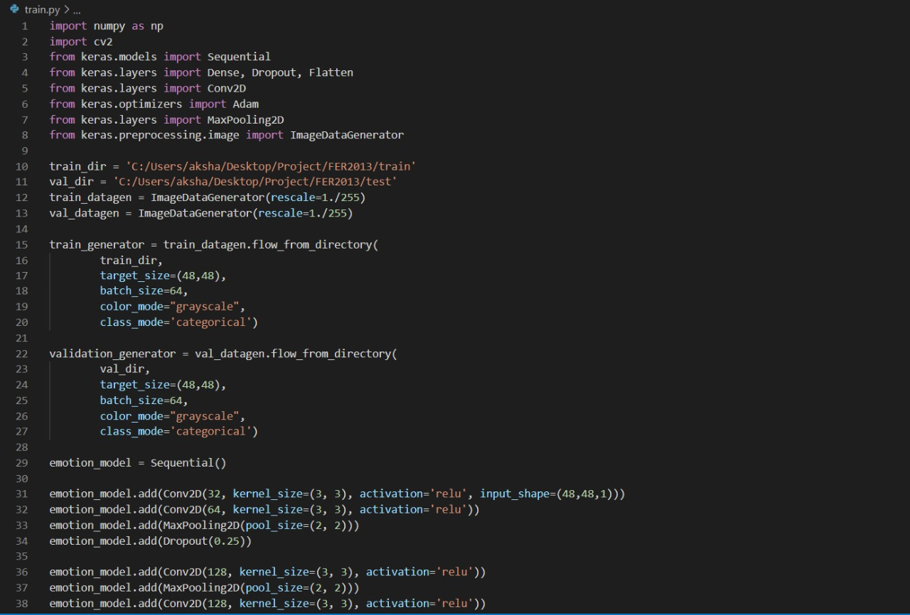
train.py

Slide 35
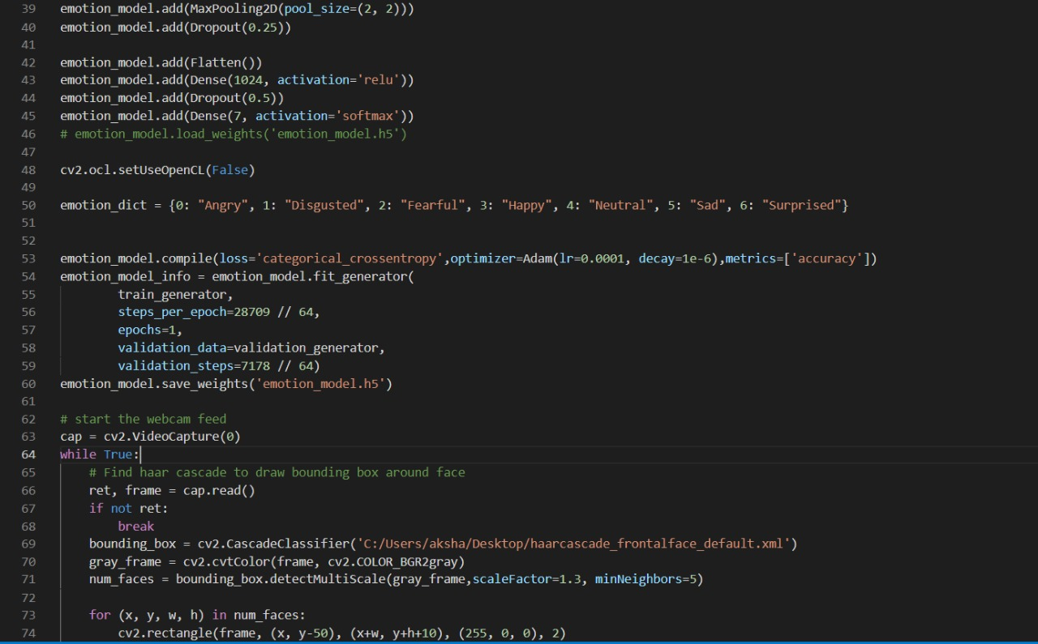
train.py

Slide 36
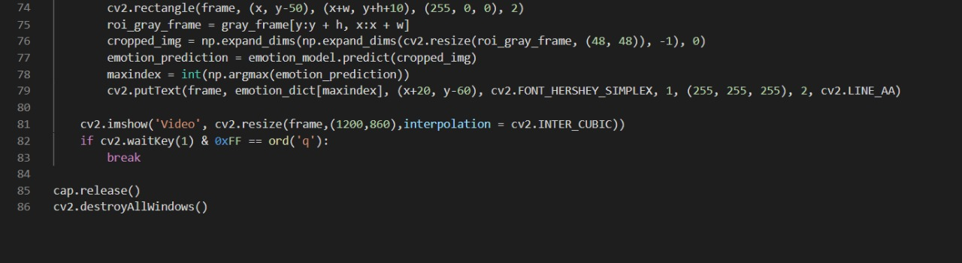
train.py

Slide 37
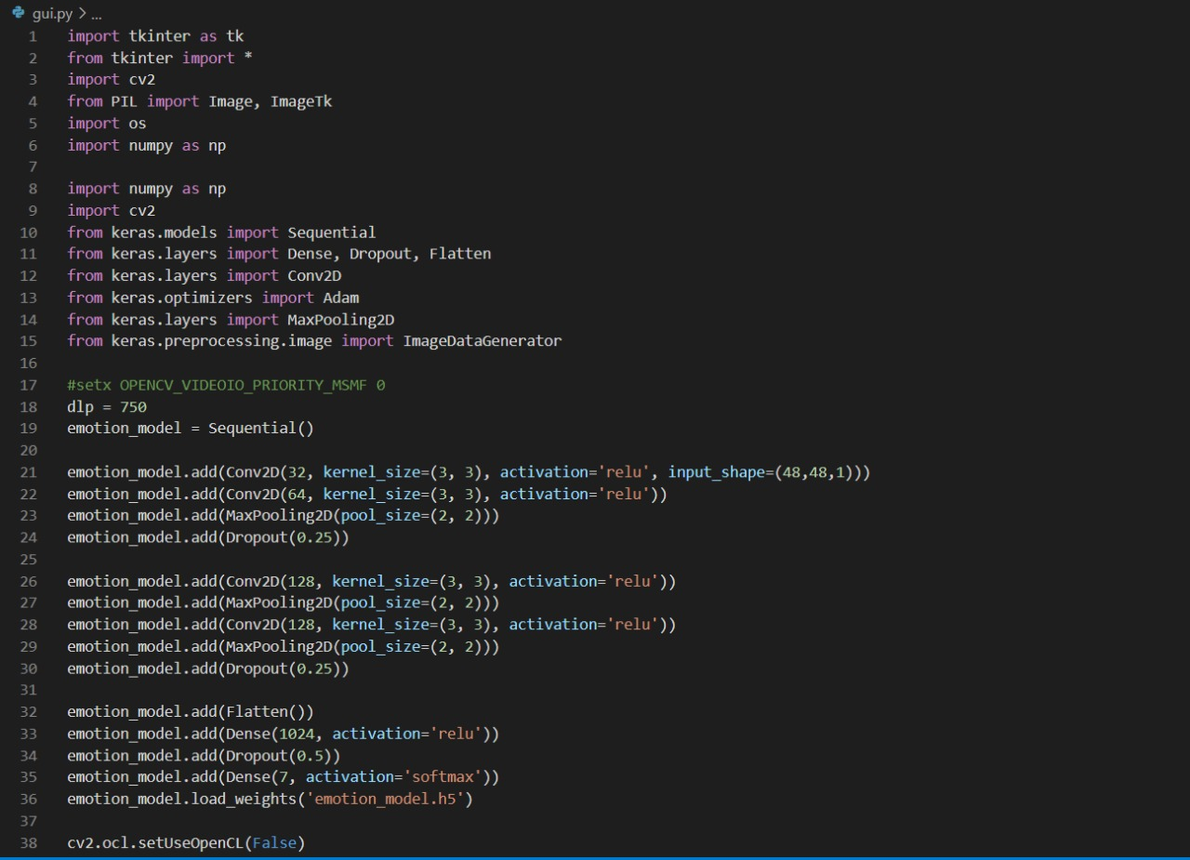
gui.py

Slide 38
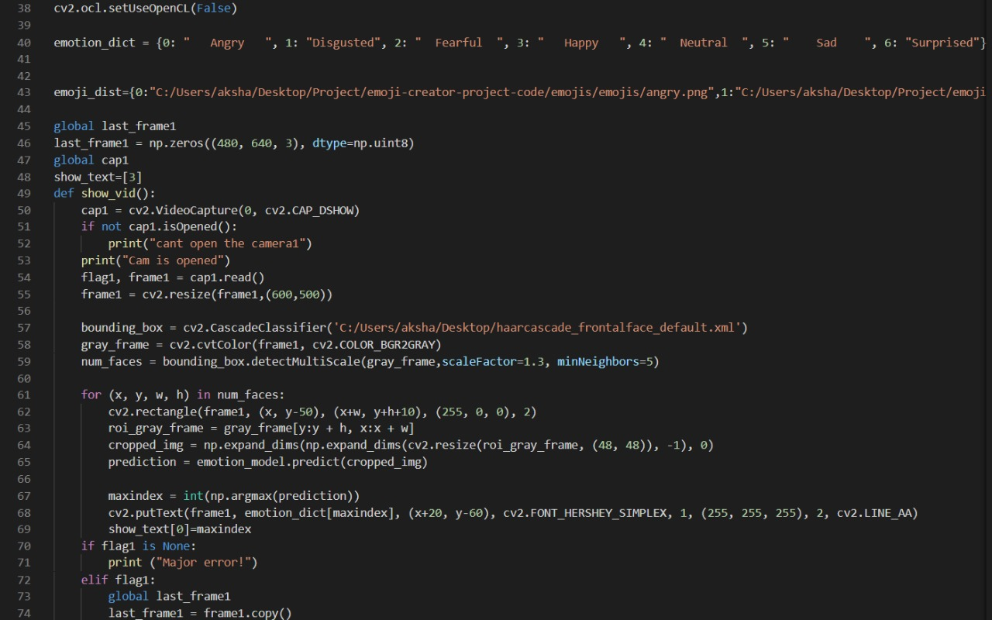
gui.py

Slide 39
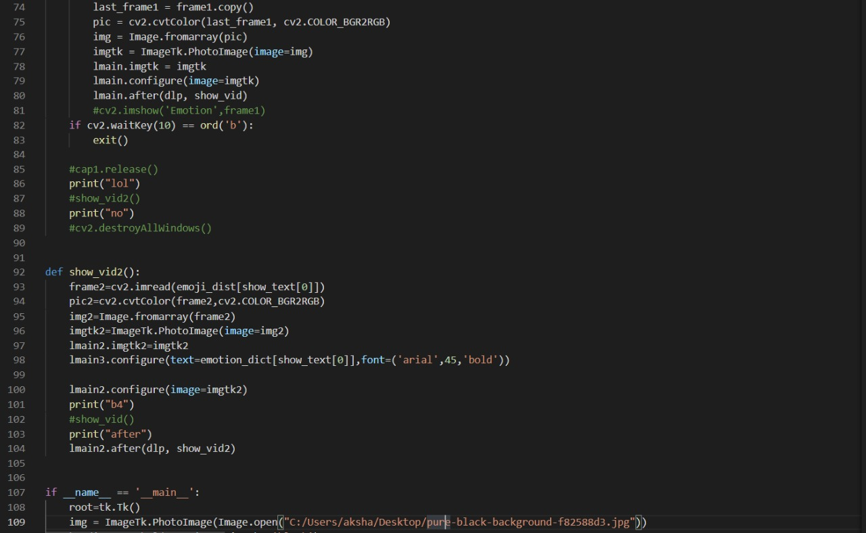
gui.py

Slide 40
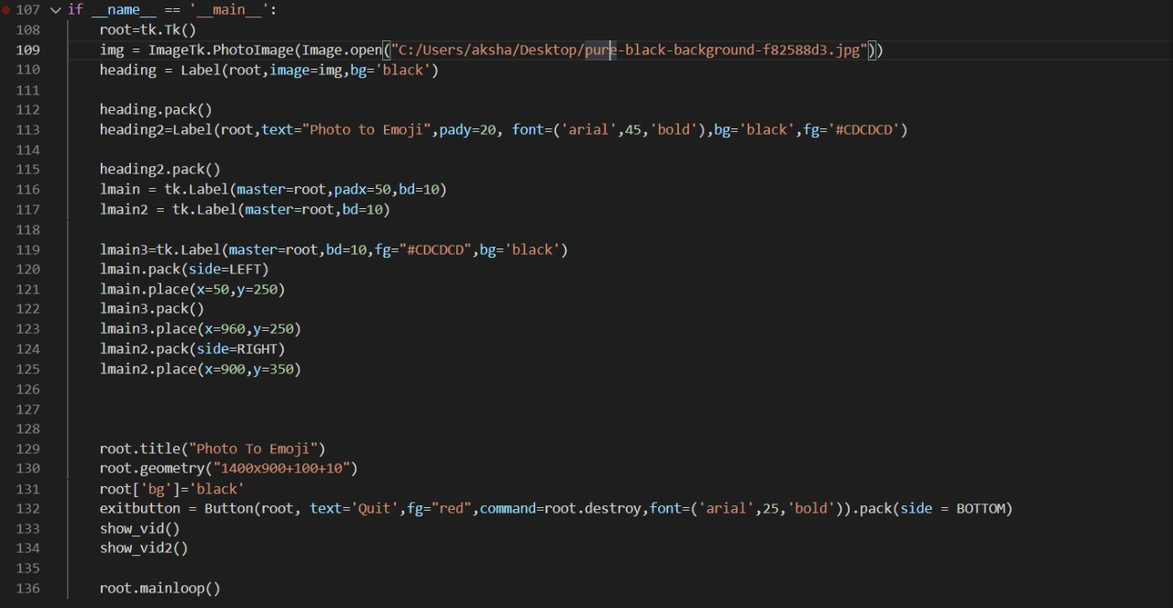
gui.py

Slide 41
Results and Discussion
(Output)

Slide 42
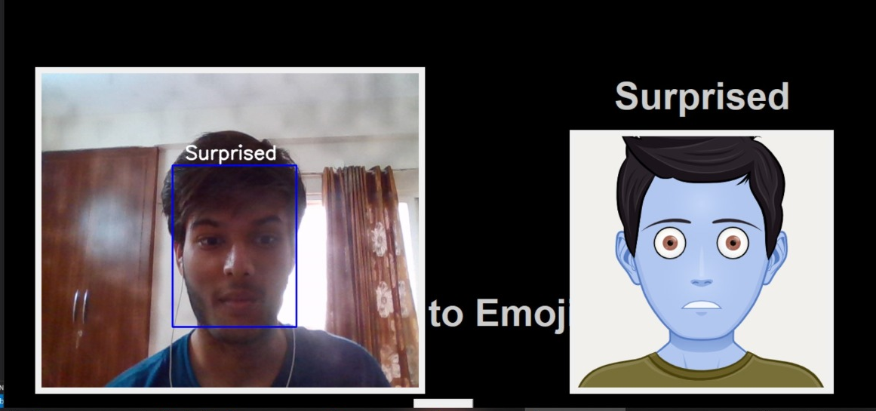

Slide 43
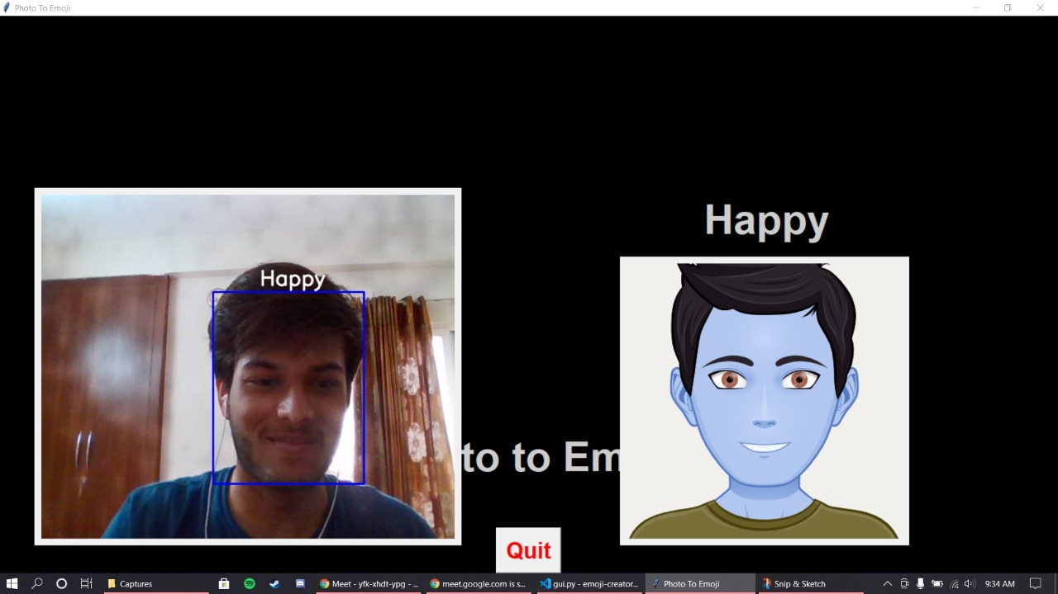

Slide 44
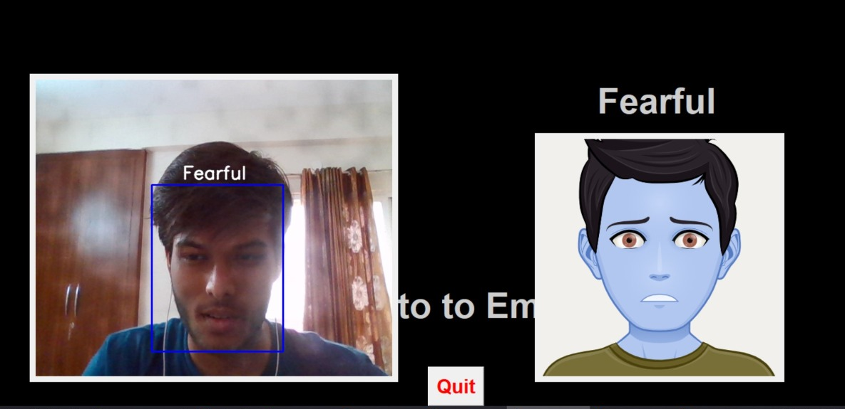

Slide 45
Result
As the application is executed the tensorflow libraries are initiated and the haarcascade frontal face classifier starts running with a bounding box on the user’s face with real time prediction of their current emotion, which is done by our CNN model from trained on the FER2013 dataset. An emoji is displayed alongside the user’s face with corresponding emotion.
The prediction and presentation are done simultaneously and in real time due to which this particular environment demands for high processing speed, which unfortunately, could not be provided due to system limitations, thus a set delay was introduced.

Slide 46
Observation
From the above outputs we can make out that the actual image and the respective emoji predicted by the model have same emotion representation. Thus, after training the dataset the accuracy of the model is 84.56% and loss is reduced to 0.3 thus we can expect that this model is capable enough to give somewhat accurate predictions.
The tkinter module does its job at the trigger for opening and closing the camera source to capture frames and display them depending on the set delay.
The only drawback is, due to its hardware requirements the CPU usage tends to become high as the application opens and closes multiple times because of triggered mechanism of the application. To overcome this situation we had to delay the execution time from 10 millisecond to 1 second. Thus, for future recommendations we can work on building the fast and efficient system.

Slide 47
Conclusion
The use of convolutional neural networks and using the adam optimizer gives us an optimal result for our project to classify the prediction done by the trained model (emotion_model.h5).
From this we can conclude that the project predicts the emotion of the user using the haarcascade frontal face classifier and the emotion is then displayed on the bounding box which produces the image of the respective emoji.
The project is quite simple to use and would be of great use in the field of machine learning in the upcoming years.
Although the model is not the best trained for day to day usage but our future aim is to increase the accuracy and consistency of the application.

Slide 48
Thank you

